Slide 1
Amadeus
An App for Musicians
Team 7
Ryuichi Ohhata, Dev Bhatia, James Wasson, Samantha Au, Brandon DeSiata

Slide 2
01
Overview

Slide 3
Proposed Solution
Connect Local Musicians
Showcase Videos
Genre
Instrument
Skill Level
Location
Display Local Shows
Bands + Individuals can enter details of local gigs
Specify genre / setlist
People can follow bands, receive notifications of their shows

Slide 4
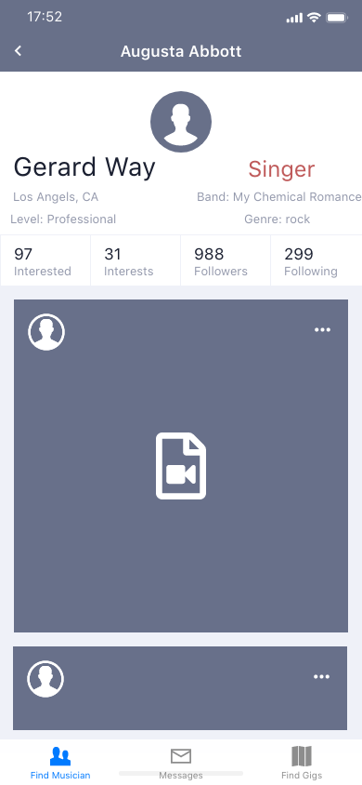
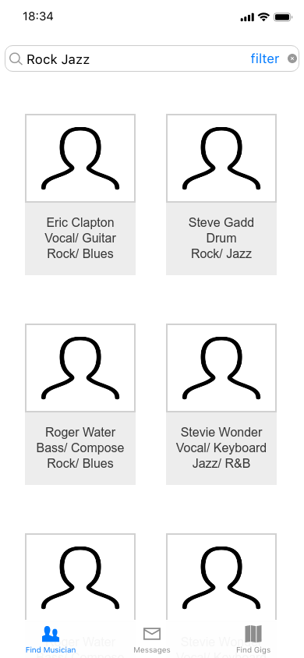
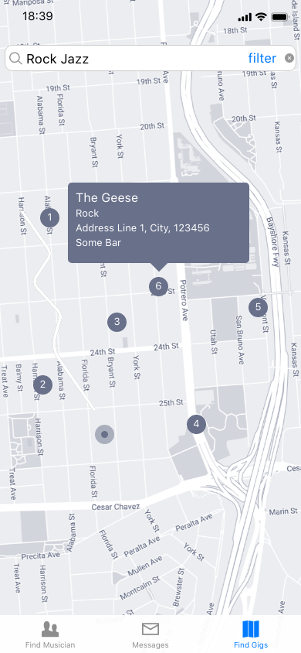
Visualization - Original UI

Slide 5
Key Requirements
Streamlined Design - The app must be easily used by a wide range (>80%) of users. The general workflow must be transparent, and adhere to the Apple AppStore technical specifications
Reliable and Efficient Communication - Messaging should happen with very infrequent erros (<1% Do Not Send), and deliver relatively quickly (< 30 seconds with strong network)
Accurate Location Data - The location data must be able to pinpoint an exact location (address) on the generated map (+/- 0.5 miles)
Secure Backend - Our application should securely store passwords and user data, subject to pen-tests

Slide 6
Final Deliverable
Complete Shippable Application
Profiles + Search Functionality
User-to-user communication
Messaging board
Authentication
Map data

Slide 7
02
System Views

Slide 8
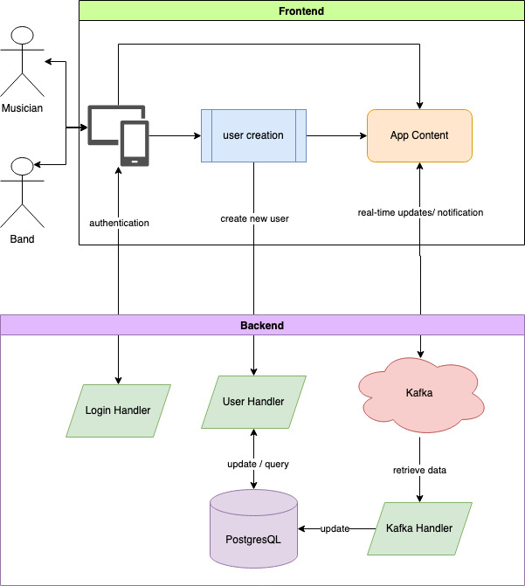
Overall System

Slide 9
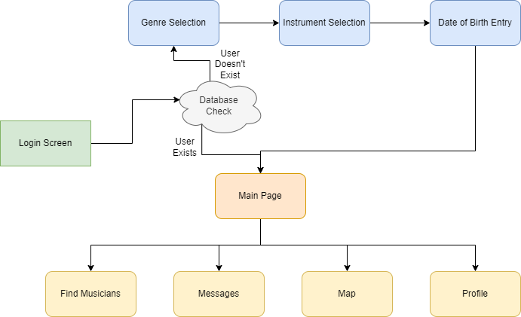
Screen Flow

Slide 10
03
Technology & Design

Slide 11

Demo

Slide 12
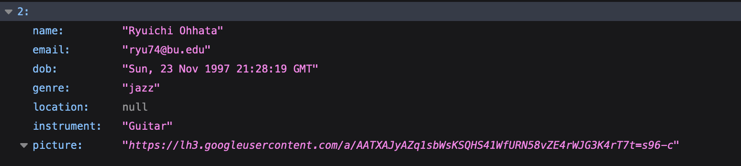
API
Python Flask and RESTful
Interacts with PostgresQL using GET, POST, PUT, and DELETE requests to appropriate endpoints
Handles user authentication
Frontend – uses Google API to obtain access and ID tokens
Backend – receives access and ID tokens and uses Google API to verify them

Slide 13
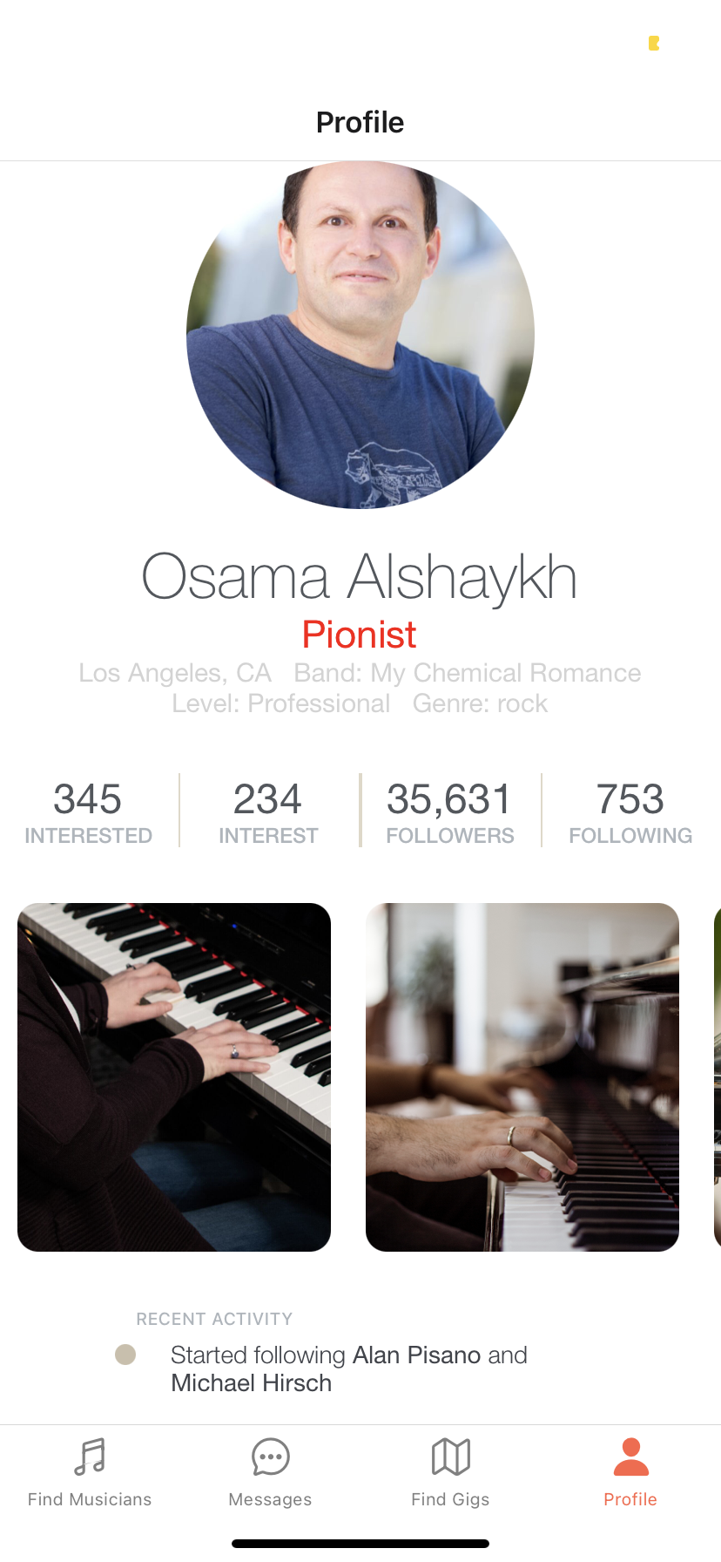
User Interface
compiled in ReactNative with Expo - allow cross-platform framework, features reusable components, and includes hot reload feature
Completed
Navigation between each tabs and screens
Setting up the UI design for
profile page
home page/ Find Musicians
Next steps?
Improve user-friendliness for home page with react-native-super-grid library
Integrate videos into user’s profile
Connect user’s data to Google Firebase

Slide 14
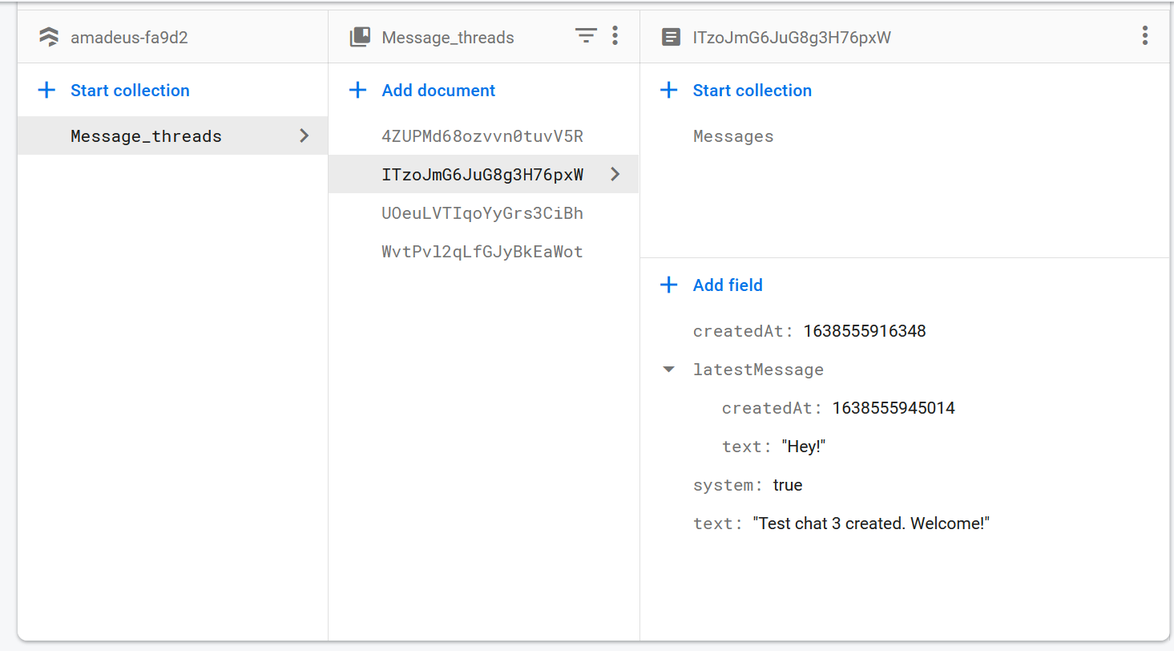
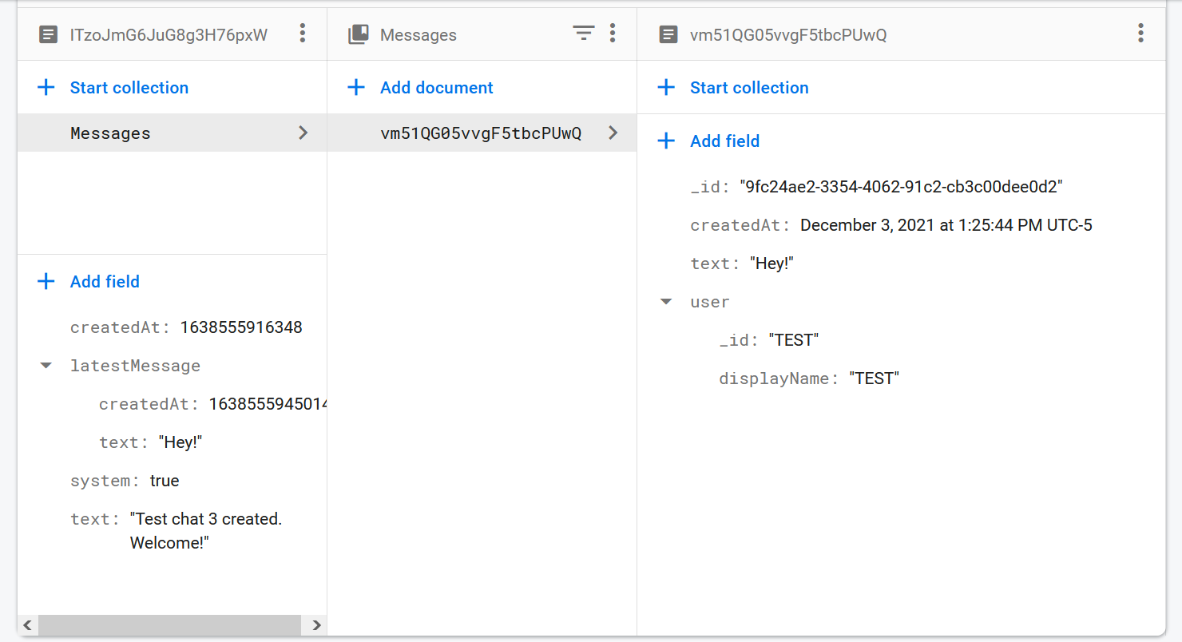
Messaging
- Each messages thread is a documents in a FireStore Database
- Each thread contains a collection of documents containing messages
- Metadata stored with each message

Slide 15
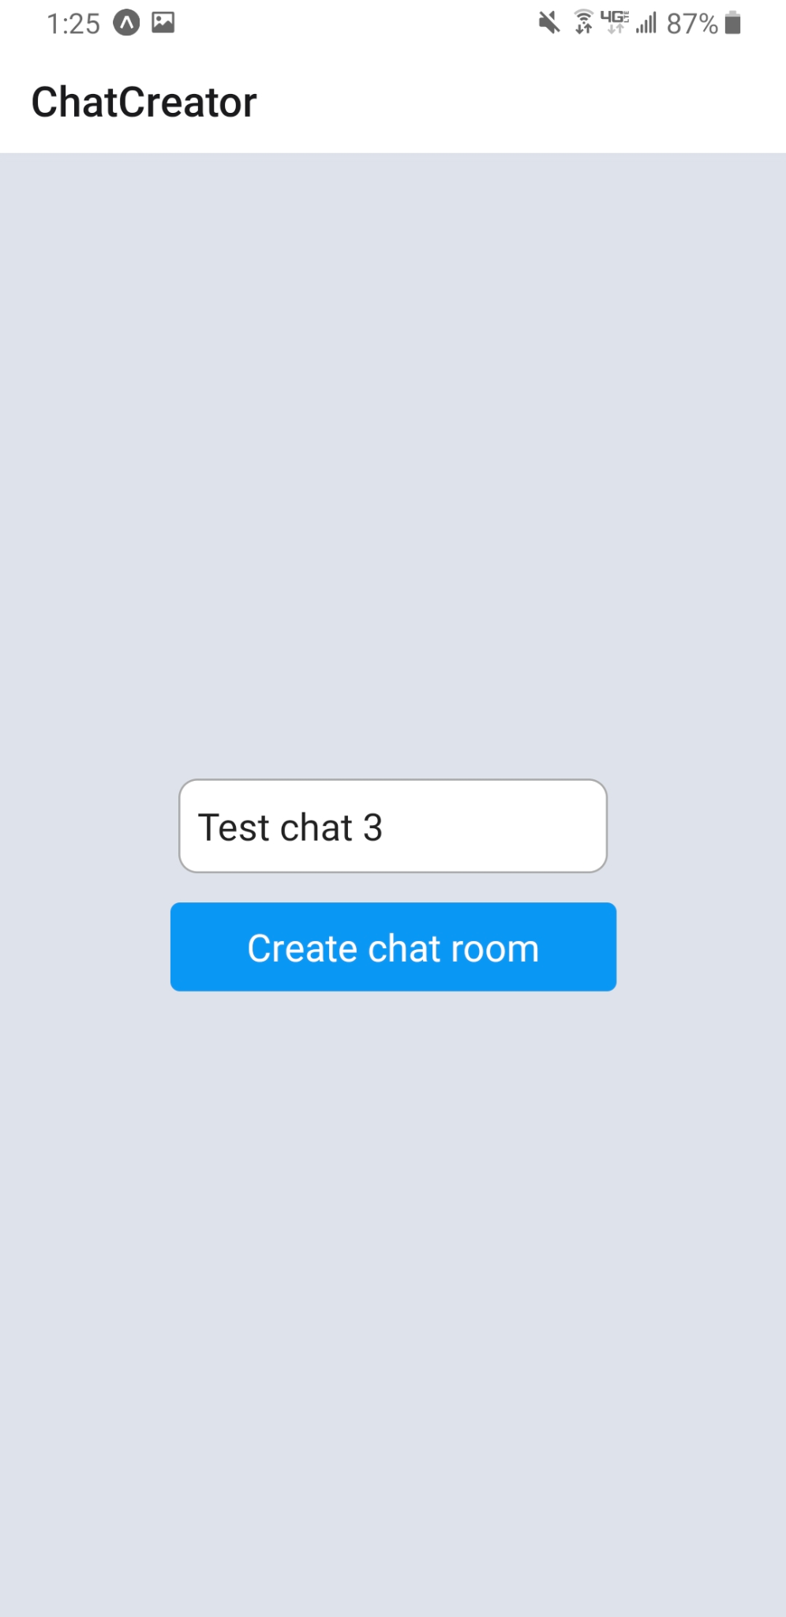
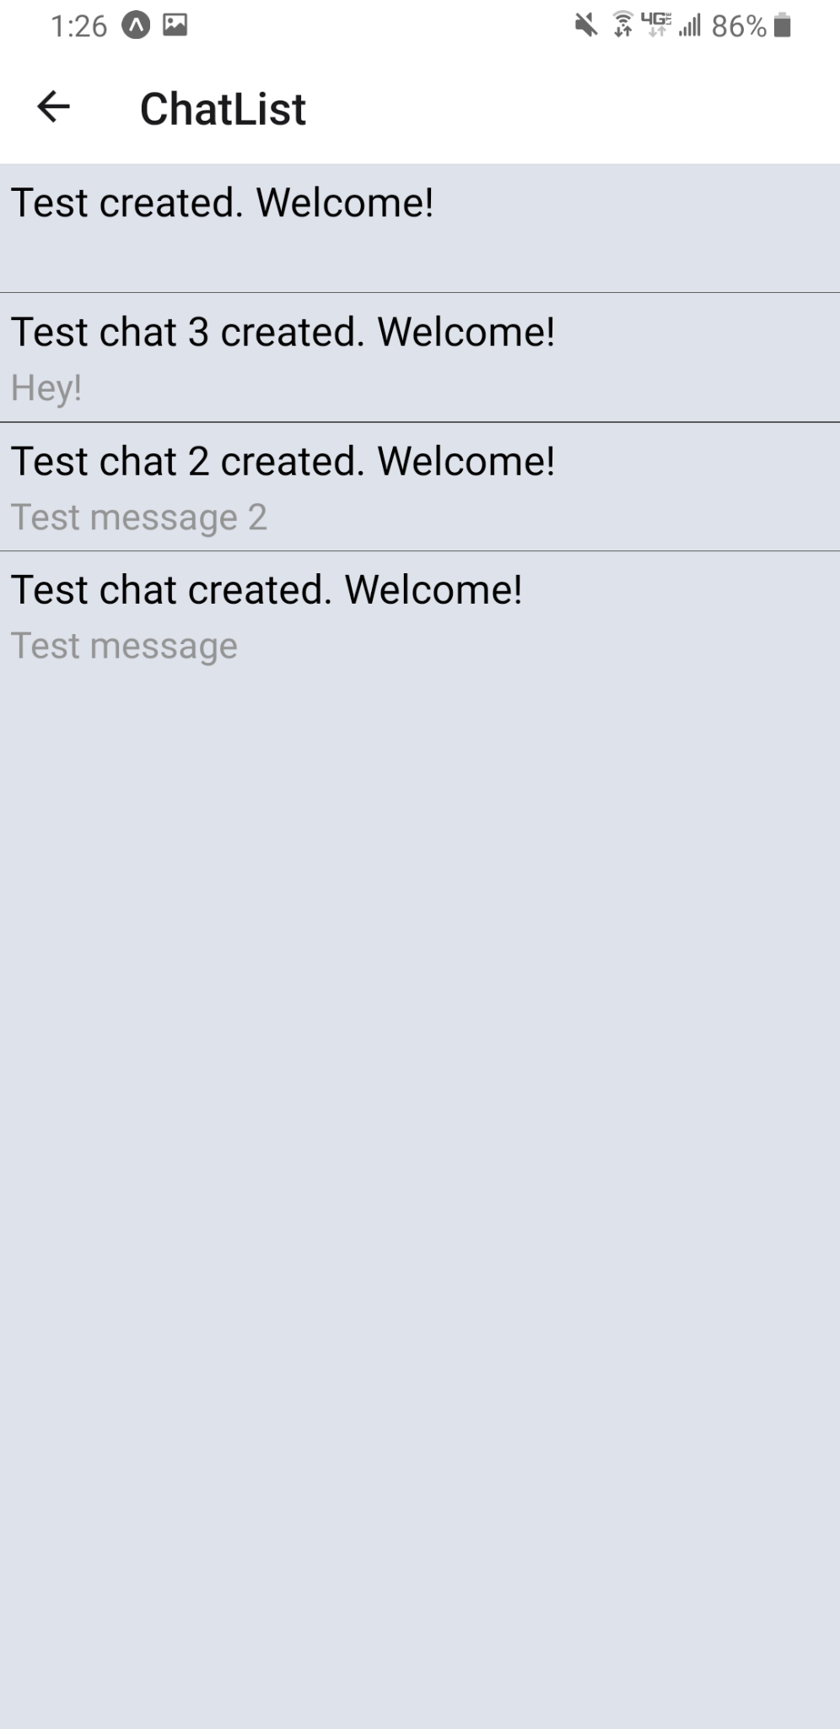
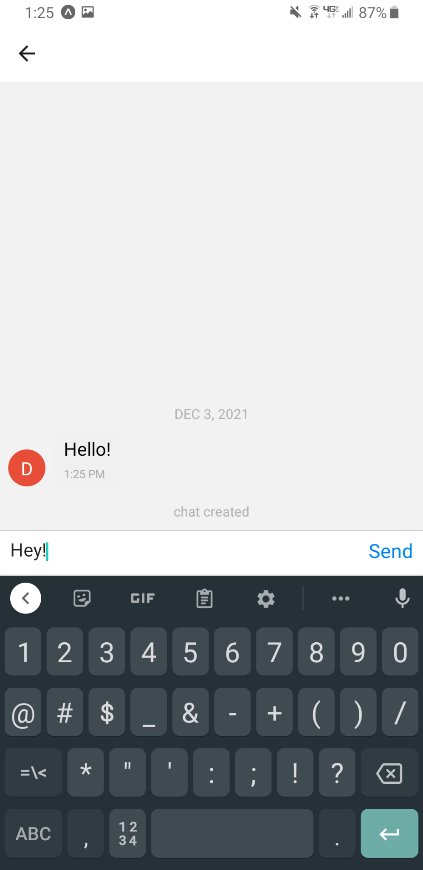

Slide 16
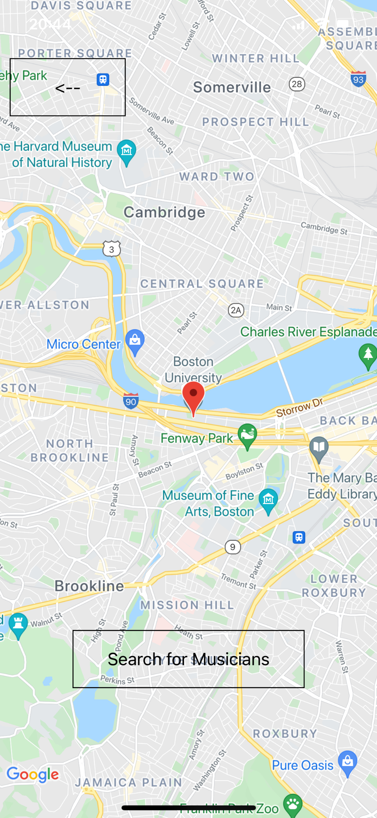
Google Maps API
Functionality:
Allow user to input location
Search for venues
See other users in the area
Draggable cursor

Slide 17
04
Schedule

Slide 18
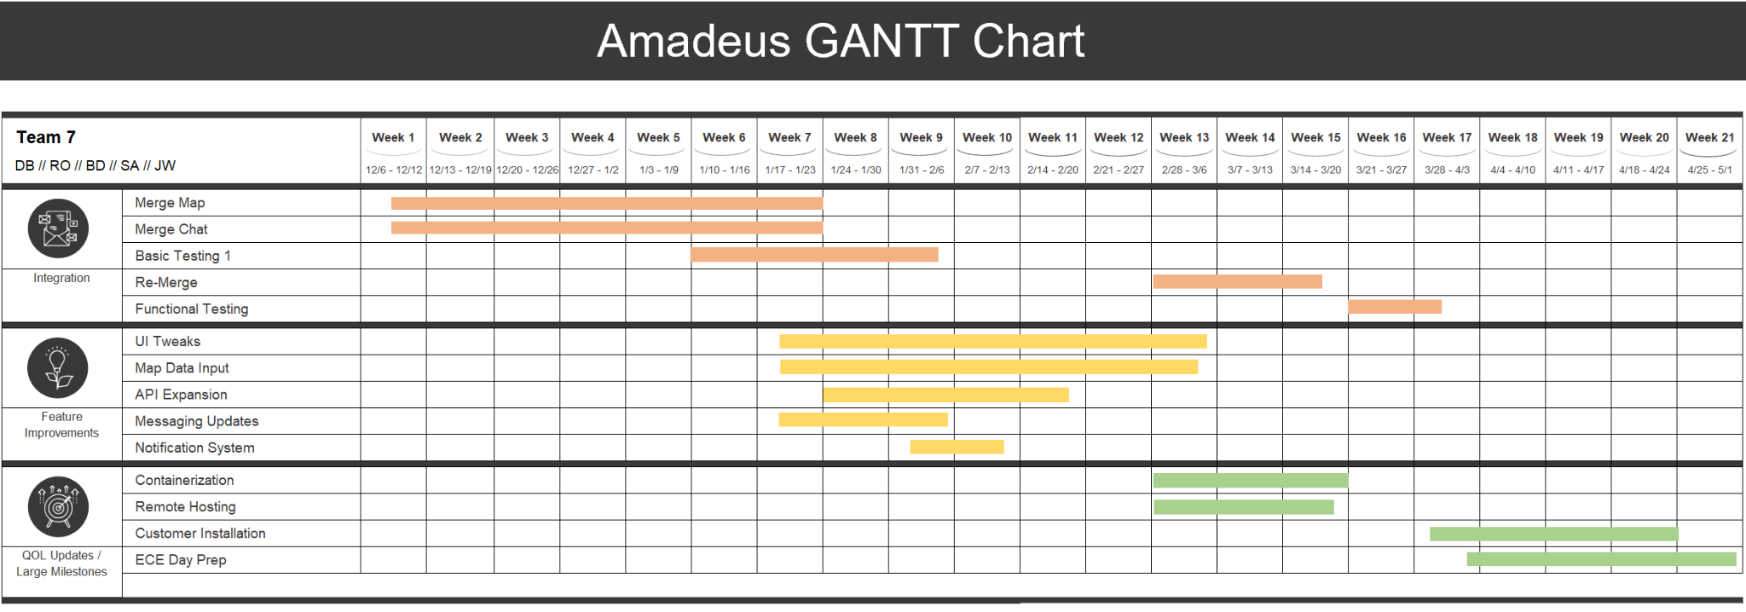

Slide 19
Thank You For Listening

